Slide 1
CLASIFICADOR DE NOTICIAS
PRUEBA ML ENGINEER Whale & Jaguar
Cesar Nieto

Slide 2
Catalogando noticias a partir de el titulo y la descripción corta
Es posible catalogar noticias a partir de la descripción y los titulares?

Slide 3
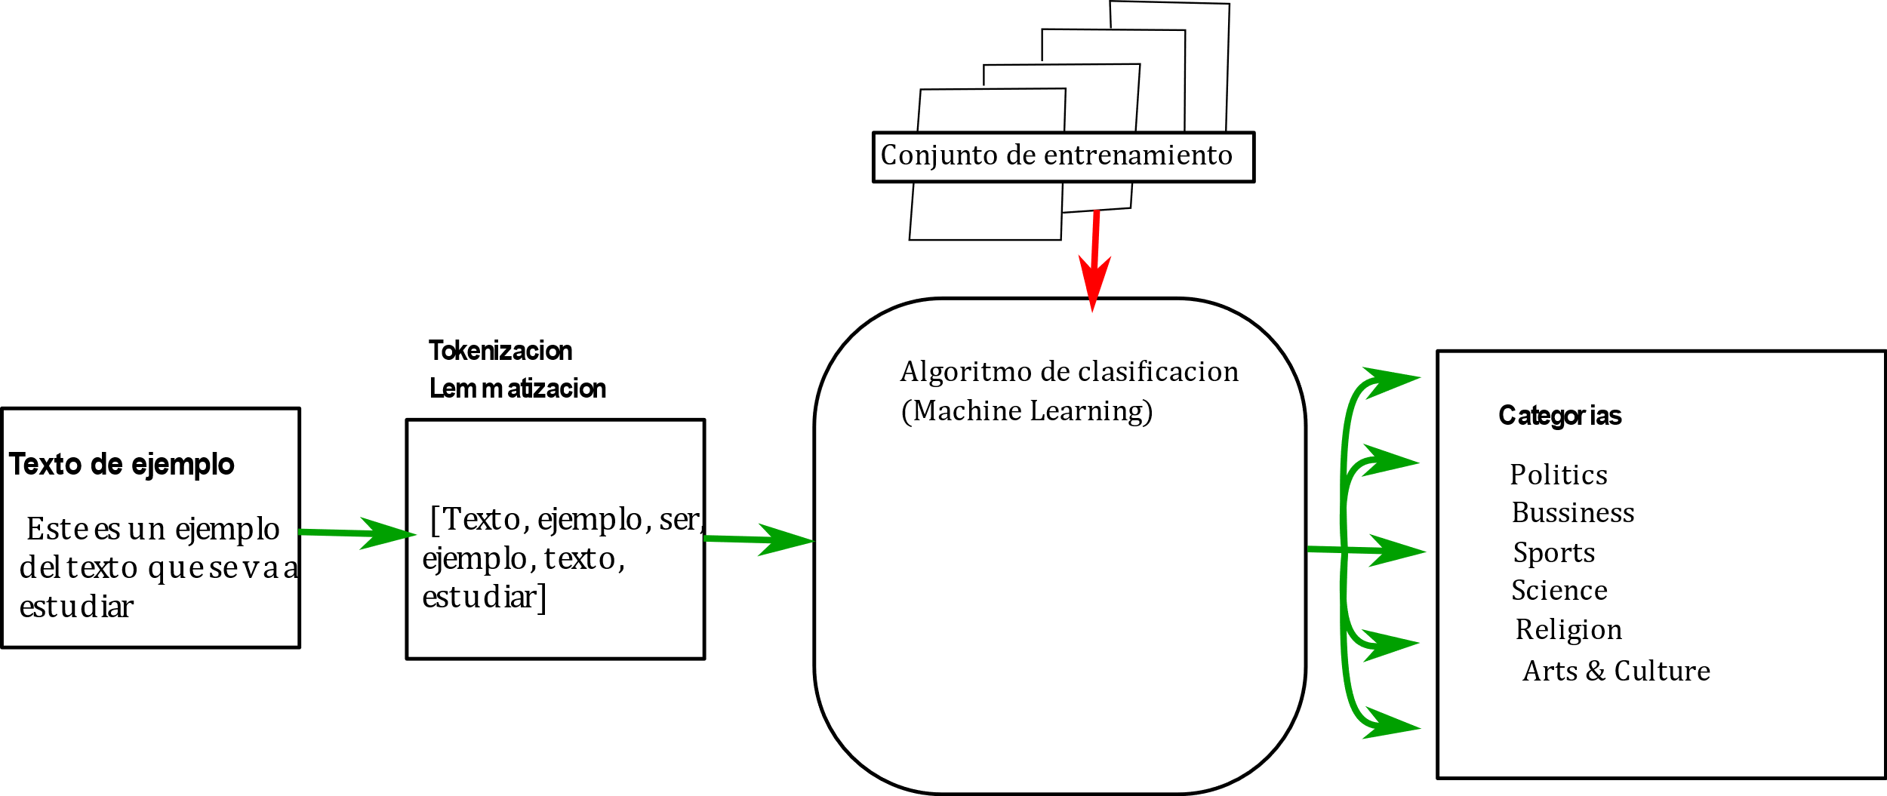

Algortimo de clasificación

Slide 4


Desempeño del algoritmo de clasificación.
CATEGORY | precision | recall | f1-score | support
ARTS | 0 | 0 | 0 | 4
ARTS & CULTURE | 0.57 | 0.24 | 0.34 | 170
BLACK VOICES | 0.57 | 0.38 | 0.46 | 331
BUSINESS | 0.44 | 0.14 | 0.21 | 134
COLLEGE | 0.33 | 0.08 | 0.12 | 13
COMEDY | 0.69 | 0.45 | 0.54 | 418
CRIME | 0.71 | 0.45 | 0.55 | 187
EDUCATION | 0.45 | 0.22 | 0.29 | 65
ENTERTAINMENT | 0.53 | 0.76 | 0.63 | 1244
FIFTY | 0 | 0 | 0 | 11
GOOD NEWS | 0 | 0 | 0 | 35
GREEN | 0.52 | 0.16 | 0.25 | 147
HEALTHY LIVING | 0.55 | 0.48 | 0.51 | 390
IMPACT | 0.17 | 0.01 | 0.02 | 126
LATINO VOICES | 0.8 | 0.1 | 0.18 | 120
MEDIA | 0.61 | 0.23 | 0.34 | 198
PARENTS | 0.62 | 0.58 | 0.6 | 333
POLITICS | 0.63 | 0.93 | 0.75 | 3491
QUEER VOICES | 0.82 | 0.65 | 0.73 | 475
RELIGION | 0.42 | 0.12 | 0.19 | 120
SCIENCE | 0.5 | 0.07 | 0.12 | 45
SPORTS | 0.58 | 0.44 | 0.5 | 176
STYLE | 0.5 | 0.26 | 0.34 | 133
TASTE | 0.74 | 0.53 | 0.62 | 132
TECH | 0.43 | 0.06 | 0.1 | 54
THE WORLDPOST | 0.49 | 0.3 | 0.37 | 421
TRAVEL | 0.67 | 0.33 | 0.44 | 88
WEIRD NEWS | 0.51 | 0.19 | 0.28 | 181
WOMEN | 0.47 | 0.34 | 0.39 | 289
WORLD NEWS | 0.48 | 0.29 | 0.36 | 450
WORLDPOST | 0 | 0 | 0 | 19
avg/total | 0.59 | 0.6 | 0.56 | 10000
Entrenamiento con 40000 textos de prueba
$$P=\frac{tp}{tp+fp}$$
Se utilizo regresión logística.
$$R=\frac{tp}{tp+fn}$$

Slide 5
Estilo de escritura de cada categoria
¿Existen estilos de escritura asociados a cada categoría?

Slide 6
Algoritmo de estimación de palabras mas utilizadas
Escoger el 50 artículos de cada categoría.
Para cada categoría, tokenizar y lematizar cada articulo. Encontrar las 30 palabras mas frecuentes de cada articulo.
Buscar las 50 palabras que mas aparecen en artículos.
Una vez obtenidas las palabras mas comunes en cada categoría, descartar las que se repiten en 15 categorías o mas.
Realizar el diagrama wordcloud con las palabras mas comunes y con la frecuencia que aparece en los artículos.

Slide 7
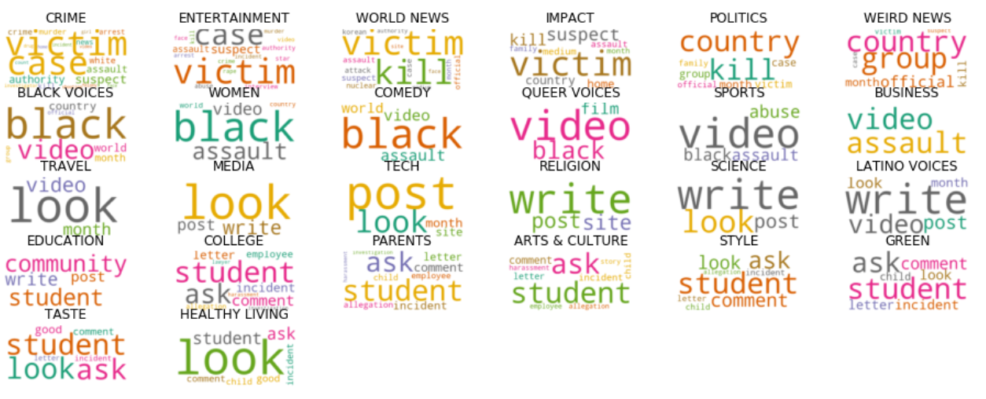
Palabras mas usadas por categoría

Slide 8
Estilo de escritura de cada autor
¿Qué se puede decir de los autores a partir de los datos?

Slide 9
Algoritmo de estimación de palabras mas utilizadas por autor
Escoger el 50 artículos de cada autor.
Para cada autor, tokenizar y lematizar cada articulo. Encontrar las 30 palabras mas frecuentes de cada articulo.
Buscar las 50 palabras que mas aparecen en artículos considerando todos los artículos por autor.
Una vez obtenidas las palabras mas comunes en cada categoría, descartar las que se repiten en 15 autores o mas.
Realizar el diagrama wordcloud con las palabras mas comunes y con la frecuencia que son utilizadas por autor.

Slide 10
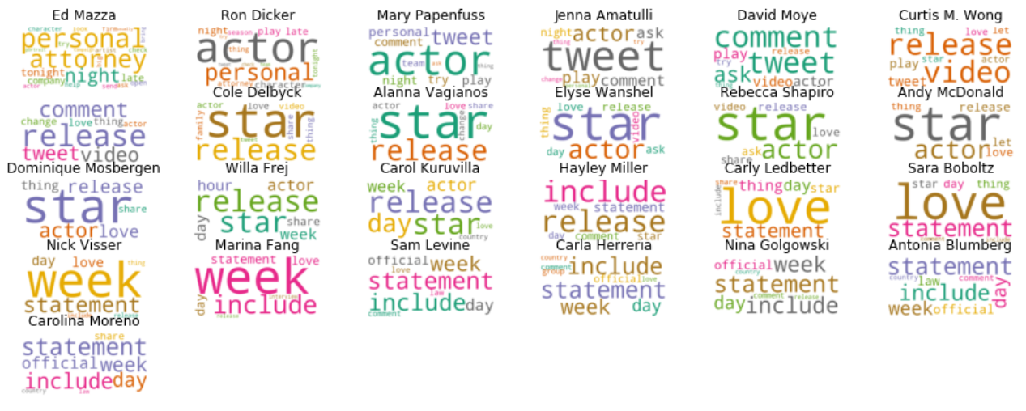
Palabras mas usada por autor

Slide 11
Algoritmo para el estudio de sentimientos de cada autor
Escoger el 50 artículos de cada autor.
Para cada autor, tokenizar y lematizar cada articulo.
Para cada articulo, estimar los coeficientes de polarización y de subjetividad. Almacenar estos puntajes para todos los artículos.
Realizar la grafica de distribución de los datos de polarización y subjetividad para cada autor
Estimar el promedio y varianza de los histogramas de polarización y subjetividad.

Slide 12
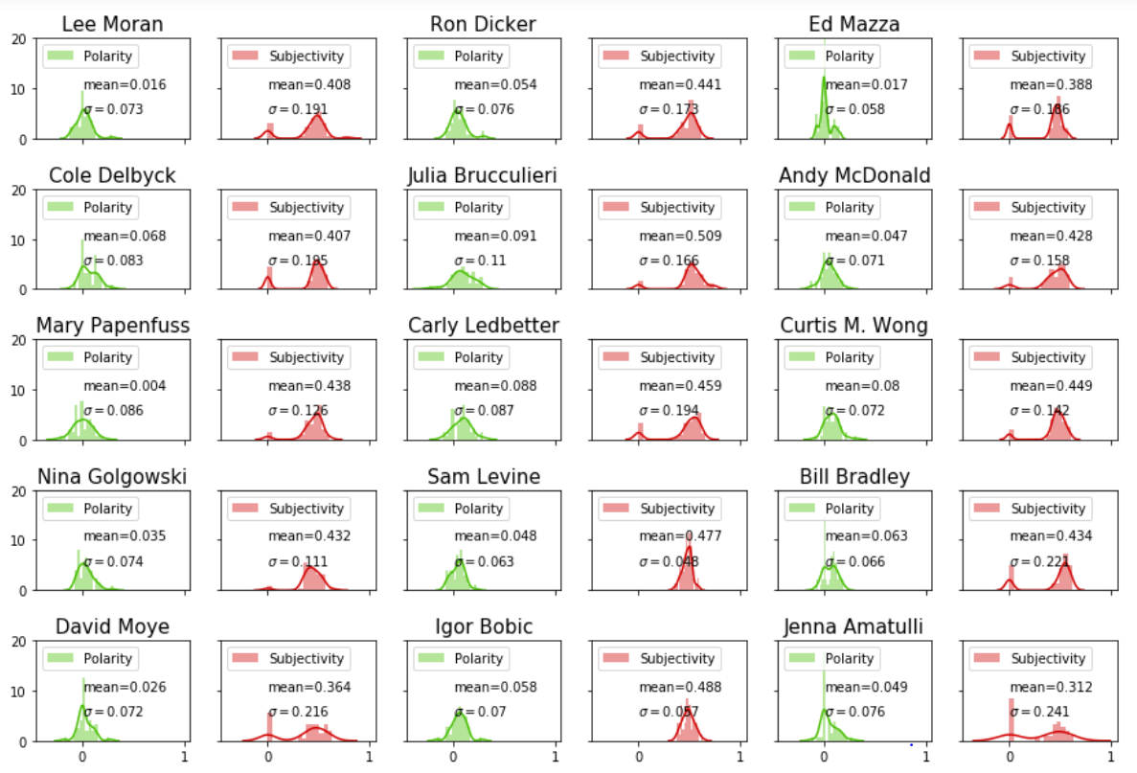
Estudio de sentimientos por cada autor

Slide 13
Identificación de temas de las noticias

Slide 14
Algoritmo para la obtención de temas
Escoger el 50 artículos de cada categoria.
Para cada categoria, tokenizar y lematizar cada articulo.
Calcular las palabras clave mas utilizadas en cada articulo
Utilizar estas palabras mas usadas para obtener clusters de palabras utilizando el algoritmo Latent Dirichlet Allocation.
Obtener los cinco clusters principales con 10 palabras cada uno.

Slide 15
Topic Modeling: Latent Dirichlet Allocation (LDA)
 | Topic 0 | Topic 1 | Topic 2 | Topic 3 | Topic 4
CRIME | victim, case, assault, prosecutor, sexual, man, woman, attorney, abuse, lawyer | child, bus, girl, home, kid, school, nah, leave, family, face | suspect, victim, case, investigator, crime, school, authority, site, kill, hour | assault, woman, sexual, victim, lawsuit, trial, case, jury, guilty, attorney | shooting, release, officer, footage, hour, room, survivor, hearing, sentencing, period
ENTERTAINMENT | set, hard, circumstance, offer, easy, feel, hour, scene, interview, happen | victim, hard, let, murder, suspect, rule, hour, circumstance, interview, crime | school, scene, season, violence, gun, happen, series, teen, leave, cast | woman, set, sexual, let, hard, excuse, interview, feel, offer, hour | movie, offer, row, easy, let, hard, hour, rule, watch, excuse
WORLD NEWS | plane, flight, crash, official, kill, site, passenger, cuban, far, circumstance | nuclear, summit, test, korean, meeting, site, expert, program, talk, exercise | diary, abuse, page, museum, publish, entry, family, research, write, secret | group, attack, hour, israeli, military, nuclear, kill, responsibility, hard, protest | deal, party, nuclear, sanction, plastic, site, european, country, government, deep
IMPACT | farmer, worker, rice, yield, change, increase, community, country, series, climate | job, worker, income, basic, automation, virus, idea, community, union, human | woman, farmer, ikigai, tree, world, plant, plastic, study, economy, seed | community, city, business, series, percent, content, home, big, land, change | social, anxiety, mental, symptom, disorder, feel, medium, bike, health, illness
POLITICS | suit, shooting, lawsuit, winery, yacht, false, victim, file, cruise, conspiracy | ad, child, school, disclosure, public, issue, political, information, gun, site | bot, conservation, russian, tweet, group, month, research, request, meeting, spanish | neighbor, leader, love, immigrant, federal, declaration, rule, service, citizen, political | woman, abortion, rule, campaign, information, offer, share, responsibility, hard, easy

Slide 16
Topic Modeling: Latent Dirichlet Allocation (LDA)
 | Topic 0 | Topic 1 | Topic 2 | Topic 3 | Topic 4
WEIRD NEWS | squirrel, woman, student, man, seat, post, offer, point, hard, allegedly | octopus, fawn, millennial, end, offer, hard, varie, site, rule, designate | cake, order, customer, online, profane, store, sword, graduation, write, censor | message, send, ade, zombie, site, man, allegedly, hard, text, urine | let, site, offer, responsibility, hard, easy, register, excuse, impossible, circumstance
BLACK VOICES | protest, player, anthem, black, national, understand, stand, violence, sit, patriotism | black, white, look, video, dance, person, let, hurt, easy, violence | woman, black, man, rule, designate, hard, let, hour, easy, offer | feat, black, actress, film, protest, french, woman, hit, nomination, actor | black, officer, video, white, student, woman, stop, hard, violence, man
WOMEN | woman, man, sexual, assault, let, rule, hard, period, offer, hour | woman, sexual, student, allegation, harassment, festival, comment, director, male, ask | woman, sexual, man, let, rule, excuse, hour, responsibility, offer, wear | abortion, gift, woman, rape, case, look, care, mom, feel, sign | woman, girl, young, abuse, petition, man, leader, social, event, offer
COMEDY | offer, hard, let, hour, responsibility, locality, register, designate, site, citizen | hat, red, love, hit, porn, convinced, fear, rock, confuse, star | swamp, drain, shut, immigrant, let, outside, royal, black, watch, actually | coin, watch, hour, offer, excuse, site, impossible, designate, goodbye, coronavirus | episode, prove, animal, goofy, entry, competition, password, muslim, racist, late
QUEER VOICES | employee, organization, store, boy, participant, change, announce, scout, terminate, support | gay, offer, site, citizen, hour, hard, easy, let, community, period | transgender, man, photo, easy, woman, wear, site, gender, position, character | therapy, conversion, book, child, practice, young, family, love, kid, parent | church, happen, certificate, pastor, memorial, denomination, congregation, place, character, interim

Slide 17
Topic Modeling: Latent Dirichlet Allocation (LDA)
 | Topic, 0, | Topic, 1 | Topic, 2 | Topic, 3 | Topic, 4
SPORTS | athlete, excuse, sport, site, cheerleader, team, varie, offer, college, locality | college, player, school, basketball, athlete, sport, huffpost, hand, play, team | team, game, player, play, hard, pardon, point, rule, let, protest | sport, anthem, win, game, performance, song, race, play, million, finish | athlete, abuse, sexual, rule, team, female, hour, woman, let, level
BUSINESS | arbitration, sexual, harassment, group, card, breach, write, woman, assault, employee | tax, percent, city, million, offer, billion, gun, hour, rule, deal | woman, man, store, employee, business, trade, simmon, datum, offer, image | housing, city, appeal, community, environmental, resident, fight, build, supportive, homelessness | woman, sexual, assault, case, harassment, file, driver, letter, worker, public
TRAVEL | flight, attendant, travel, passenger, plane, kid, book, trip, air, good | stay, town, region, city, island, couple, worth, love, place, country | city, travel, good, beach, food, hotel, summer, weather, restaurant, month | pet, animal, airline, dog, fly, cargo, death, carrier, travel, high | room, hotel, list, travel, germ, good, summer, remote, destination, affect
MEDIA | woman, sexual, allegation, story, harassment, tape, let, network, host, hour | news, union, organization, responsibility, medium, platform, site, begin, anti, newspaper | post, write, blog, sexual, woman, network, site, harassment, claim, hard | mean, coate, question, let, actually, talk, write, story, hard, lot | business, tabloid, coverage, boss, seize, financial, lawyer, allege, payment, month
TECH | user, datum, rule, information, app, site, hour, hard, offer, let | password, user, account, bug, store, internal, twitter, believe, mask, log | emoji, flamethrower, control, information, application, birth, site, offer, hard, pill | information, robot, rule, public, forget, ruling, conviction, search, remove, court | speech, lawsuit, hate, bug, housing, child, family, discrimination, disability, exclude

Slide 18
Caracterización de las descripciones de los artículos
Basándote en el texto de la descripción corta, caracteriza este dataset.

Slide 19
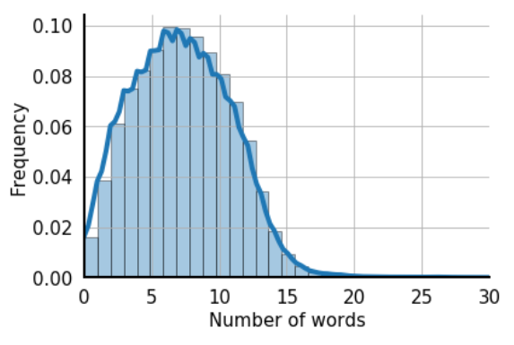
Distribución del numero de palabras clave de la descripción de los artículos

